Slide 1
NeCTAR Training
Module 1
Overview of cloud computing and NeCTAR services

Slide 2
Overview of Cloud Computing and NeCTAR Services
This course provides an introduction to the NeCTAR cloud services available to researchers across Australia
The course is structured in 10 “Modules”

Slide 3
Overview of Cloud Computing and NeCTAR Services
Complementary course material is available as an On-Line Documentation:
(TODO: Provide link)
Each Module also has a video which
Contains a compact presentation of the course material.
Sums up contents of each Module.

Slide 4
Overview of this module
Course overview
Definition of cloud computing & common services
Common concerns
What is virtualization?
Cloud computing history
Description of NeCTAR and its services
How cloud computing benefits your research

Slide 5
Course Overview
Module 1
Overview of cloud computing and the NeCTAR services
In this module you will learn what cloud computing is, what types of services NeCTAR offers, and how cloud computing may benefit your research.

Slide 6
Course Overview
Module 2
Virtual Laboratories and eResearch Tools
Introducting the “ready to go” tools.
This module provides an overview of the eResearch Tools and the Virtual Laboratories that are offered by NeCTAR services.

Slide 7
Course Overview
Module 3
Use Cases
This module deals with typical use cases in which a virtual machine is set up on the NeCTAR Research Cloud.

Slide 8
Course Overview
Module 4
From PC to Cloud or HPC
This module will discuss the differences between Cloud Computing and “High Performance Computing” (HPC), and provide an overview of pros and cons of moving from PC to Cloud or HPC.

Slide 9
Course Overview
Module 5
The Research Cloud lifecycle
A high level overview of the end-to-end lifecycle of using the Cloud. You will learn about all processes involved from getting onto the Research Cloud to maintaining your services and keeping them secure until the termination of your services.

Slide 10
Course Overview
Module 6
Resource requirements for computing an storage
Factors which help you determine the amount of resources (computing and storage) you require.
We will take a look at the different types of storage that are available to you to help you decide which type(s) suits your purposes.

Slide 11
Course Overview
Module 7
Launching & Connecting
It is time for some hands-on experience!
This module delivers a tutorial on how you can create and launch your own virtual machine, how you can connect to it and how you can attach your storage.

Slide 12
Course Overview
Module 8
Security
This module provides an introduction to key security issues, dangers and consequences when running a virtual machine in the cloud.
Practical advice is given for making your machine secure and protect your data with encryption.

Slide 13
Course Overview
Module 9
Backing up and packing up
This module will discuss backup strategies. You will learn how to back up and recover your virtual machine and your data. You will also learn how to terminate your virtual machine without losing anything.

Slide 14
Course Overview
Module 10
Beyond the Dashboard
This last module provides an overview of the OpenStack command line tools. It is designed for advanced users who want to learn more about command line tools to control the NeCTAR resources.

Slide 15
What is Cloud Computing?

Slide 16








Cloud Services
Compute
Servers
Storage
Internet
Your
Computer
Collaborator
Notes:
Simply put, cloud computing means:
So what is cloud computing?
Simply put, cloud computing means
Storing and accessing data and programs over the Internet instead of on your own computers hard drive.
[next animation]
Cloud infrastructure consists of computers
[next animation]
and storage. They are located in a data center.
[ next animation]
You can use the compute resources that you require, so a number of computers,
and some storage.
It is easy to scale up resources by requesting more at the time when you need it, easily and quickly.
You local computer is only used to connect to the resources and control them via the internet.
It shows the screen of your remote computer, and you can use your keyboard and mouse to control it.
[next animation]
You can share access to these resources with collaborators easily.
[next animation]
When you are done with your work, you can release the resources again, and they won’t incur any more maintenance activities or costs.

Slide 17
What is cloud computing
Simply put, cloud computing means:
Storing and accessing data and programs over the Internet instead of on your own computers hard drive.
You local computer is only used to connect to and control the resources.

Slide 18
Why is this good?
Your research organization may not be able to provide you with enough resources for your research easily.
In the cloud, you can easily scale up to the amount of resources you require at a time.
This model is commonly known as “pay-per-use”
Easily provide access to collaborators to the same resources.
Save time synchronizing the collaboration.

Slide 19
Cloud Computing
The National Institute for Standards and Technology (NIST) defines cloud computing as:
“[…] on-demand network access to a shared pool of configurable computing resources (e.g. […] servers, storage, […]) that can be rapidly provisioned and released with minimal management […]”

Slide 20
Cloud Computing
Five characteristics (according to NIST):
On-demand self-service
Broad network access
Resource pooling
Rapid elasticity
Measured service
Notes:
Five characteristics of cloud computing (according to NIST):
On-demand self-service
Consumers can provision resources (e.g. computing power and storage)
Broad network access
Access of compute and storage services via a variety of devices
Resource pooling
Consumers can choose the data center, but not the specific hardware device.
Rapid elasticity
Resources are scalable (“elastic”).
Measured service
The amount of resources consumers use can be monitored and metered.

Slide 21
Cloud Computing
Cloud computing enables IT infrastructure to be
More flexible:
Re-provision resources according to your needs.
Easier to use:
Provision resources quickly and easily; Little maintenance.
Cheaper:
Save significant expenditures for local infrastructure.

Slide 22
Common Cloud Services
Compute
Storage
Networking
Databases
Various software services
Development & Deployment platforms
Notes:
Compute
Computing resources for your research in form of virtual machines
Storage
Storage made up of distributed resources, but acting as one
Networking
Virtual Local Area Networks (VLAN)
Databases
Relational and non-relational database engines
Various software services
Software provided to you as a “cloud service”.
Development & Deployment platforms
Platforms for integrated developing and deploying applications directly to customers

Slide 23
Examples of Cloud Services
Google services (Google Drive, Docs, Sheets etc.)
Apple iCloud
Amazon Cloud Drive
Dropbox
Facebook, Instagram
Chromebook

Slide 24
Types of Cloud Services
Software-as-a-Service (SaaS)
The user subscribes to an application which they access over the Internet.
Examples: Dropbox, Google Applications.
Platform-as-a-Service (PaaS)
The user can create its own custom applications and directly deploy them.
Examples: Windows Azure, Google App Engine.
Infrastructure-as-a-Service (IaaS)
Computing resources (computers, storage, …) are provided to the user.
Examples: AWS (Amazon), Google Compute, NeCTAR Research Cloud.
Notes:
Don’t forget to note: Researchers will probably find IaaS services most useful, while SaaS tools are broadly useful for individual work and collaboration.

Slide 25
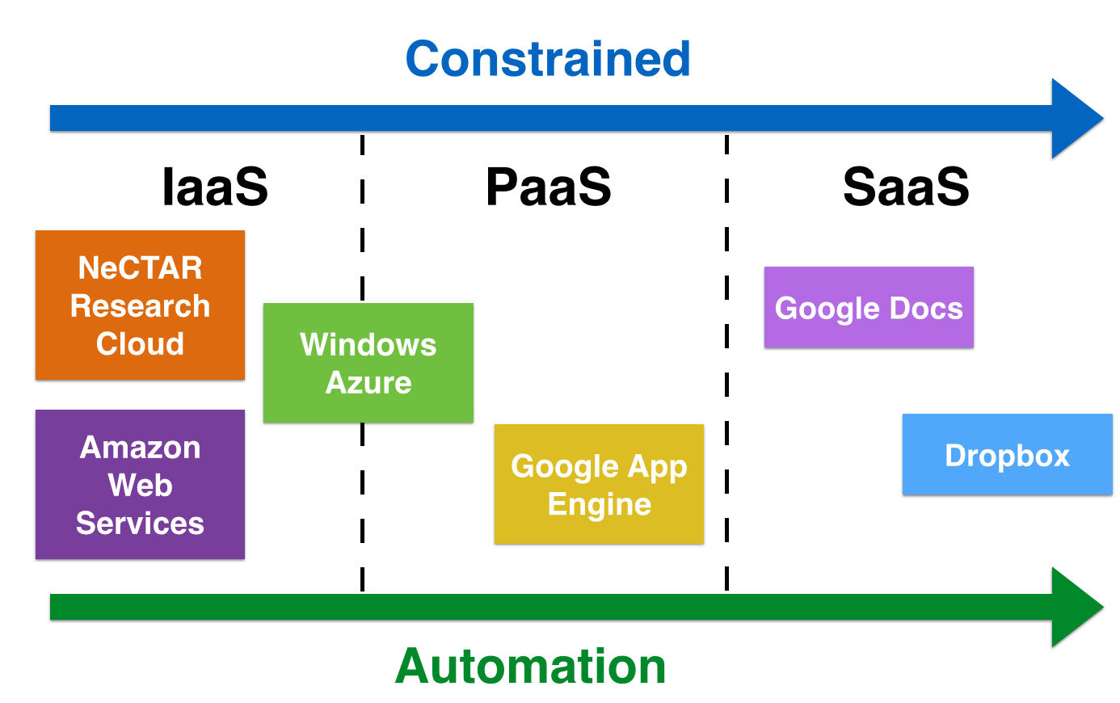
Types of Cloud Services
The 3 service types can be characterized with two properties:
Constrainedness and Automation.

Slide 26
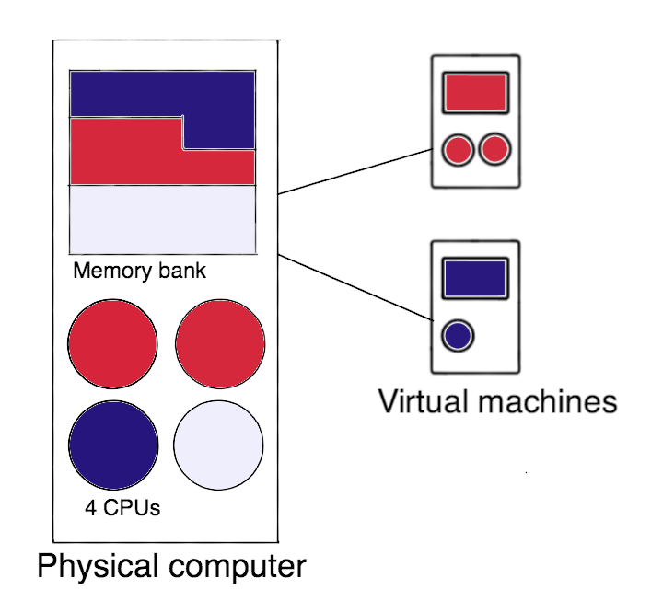
Virtualization
Virtualization basically means that the hardware is “simulated”.
We can simulate a whole computer incl. the OS.
Several virtual computers can run on one larger, more powerful computer
Notes:
Virtualization is the main technology enabling IaaS services.
A VM is utilising (parts of) the real hardware to simulate virtual hardware.

Slide 27
Virtual vs. Real Computer
“Real machine”: physical computer.
“Virtual machine” (VM): simulated computer.
Differences and similarities:
Similarities: Both have an operating system, network access (a real IP address), and hard disk storage.
Differences: No hardware maintenance for VMs. “Snapshots” of VMs for useful for backup and restore purposes.
Notes:
Simulated computer is running on another computer

Slide 28
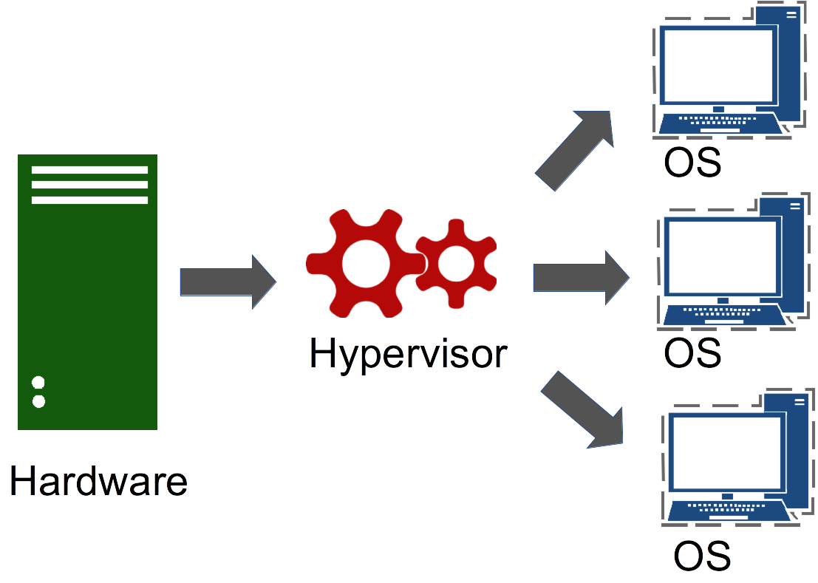
Hypervisor
The Hypervisor or
Virtual Machine Manager
is the software that manages communication between the physical hardware and and the VMs running on it.
Notes:
The Hypervisor enables the technology — but also brings new vulnerabilities. We will discuss how they are addressed in Module 8.

Slide 29
Common concerns
Common concerns when adopting cloud computing include:
Uninterrupted access to services
Privacy & Security
Portability of tools and data to and from different (cloud) platforms
Uncertainty of cost prediction
Absence of software tools
Module 8 will discuss the common concerns in more detail.

Slide 30
History
1950s: Early forms are mainframes and connected clients.
1990s: “Time sharing” technique introduced, allowing more users access to large-scale computing.
2000s: Cloud computing comes into existence.

Slide 31
History
2006: Amazon Web Services (AWS) provides storage space (S3) and computing resources (EC2).
2008: OpenNebula becomes first open-source software for deploying clouds.
2008: Microsoft Azure and Google Cloud Platform launched.
2010: Rackspace Hosting and NASA launch open-source deployment platform OpenStack. NeCTAR uses OpenStack!
until today: More cloud providers introduced to the market.

Slide 32
NeCTAR Services
2010: Australian research community voices their need for flexible, low cost, on demand computing resources.
Australian government is now funding a Cloud.
NeCTAR (National eResearch Collaboration Tools and Resources) is an Australian Government project.
Notes:
In 2010, the Australian research community voices their need for flexible, low cost computing resources that can be accessed on demand.
As a result, Australian government is now funding a Cloud that is making it simple for researchers to access IT resources.
NeCTAR (National eResearch Collaboration Tools and Resources) is an Australian Government project.

Slide 33
NeCTAR Services
The NeCTAR project aims to support the “connected researcher”:
The vision is to enhance research collaboration by building information and communications technology infrastructure.
NeCTAR is building:
Virtual Laboratories
eResearch Tools
The Australian Research Cloud

Slide 34
NeCTAR Services
Virtual Labs and eResearch Tools will be covered in Module 2.
The majority of this course will deal with the Australian Research Cloud:
A secure and robust Infrastructure-as-a-Service (IaaS).
Notes:
Mention that the AAF lets you access your services using your institutional login details (e.g. the normal university login)

Slide 35
Australian Research Cloud
Currently consists of
8 “Nodes” (data centers) with
32.000 processor cores distributed across Australia.
The completed cloud will be one of the largest OpenStack based clouds in production worldwide.
Free access for Australian researchers through the Australian Access Federation (AAF).
Notes:
Mention that the AAF lets you access your services using your institutional login details (e.g. the normal university login)

Slide 36
Benefits for your research
Concentrate on your work instead of spending time to obtain and maintain hardware.
Take advantage of a cost-effective IT infrastructure.
Shared infrastructure → easier collaboration.
Notes:
See Tutorial / Documentation for elaboration of usage models – say one sentence or two to each point.

Slide 37
Benefits for your research
New usage models are supported:
Ad-hoc computational requirements.
Reproducible research.
Teaching: Students use their own isolated work environment.
Effective collaboration, e.g. shared development workspaces.
Big data demands.
Notes:
See Tutorial / Documentation for elaboration of usage models – say one sentence or two to each point.

Slide 38
What the future holds
Cloud computing is becoming a standard technology.
Most efficient and easiest way to gain access to IT resources.
“Sustainable research” through shared infrastructure

Slide 39
Closing note
You have now learned the basics of Cloud Computing:
what cloud computing and virtualization is
common cloud services and service types
a bit of history
what NeCTAR is and what services it offers to you
how cloud computing benefits your research
By taking this course, you are on your way to gain important skills of doing research using cloud computing services!

